Slide 1
OE-6b(MACHINE LEARNING)
PROJECT PRESENTATION
PRESENTER Course Faculty
PARTHIV RAWAT Ass. Prof. KUSUM K BHARTI

Slide 2
GOAL OF THE PROJECT
A MACHINE LEARNING ALGORITHM WHICH ANALYSE THE DATA FOR PATIENTS SHOWING ATTRIBUTES OF HEART DISEASE AND COMPARE THE ACCURACY OF FINDING HEART DISEASE USING DIFFERENT MACHINE LEARNING ALGORITHMS

Slide 3
AGENDA
PROJECT BACKGROUND
DATA PREPARATION
ML MODELS AND EVALUATION
CONCLUSION

Slide 4

PROJECT BACKGROUND
Are you experiencing chest pain?
May be your heart is at the fault.
The chest pain can affect the mood, concentration, and basic Functioning of the human being.
Medications like Aspirin, Blood Thinners, Artery relaxers is Fundamental to chest pain.

Slide 5
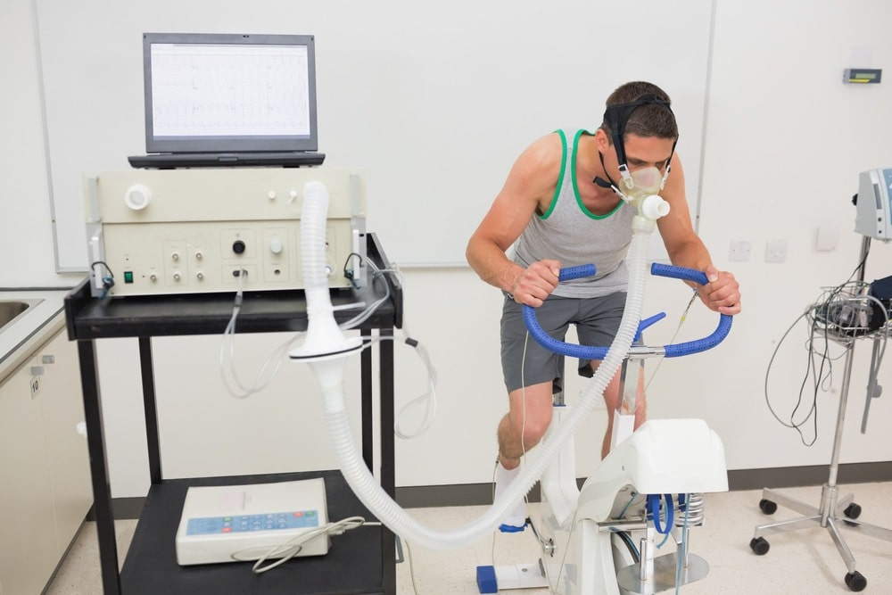
Diagnosis Using Stress Thallium Test
Disadvantages:
Increased angina pain during test
Extreme swings in blood pressure
Skin Rashes

Slide 6
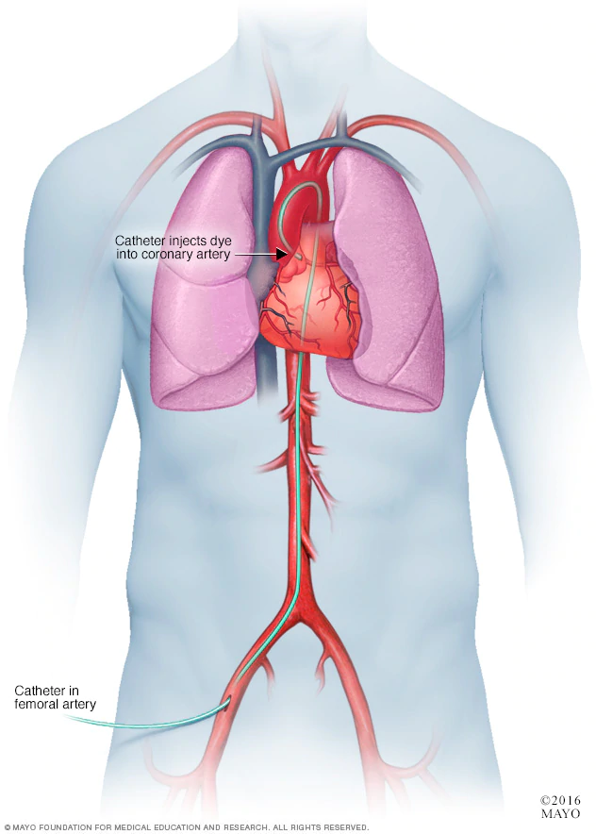
Diagnosis Using Coronary Angiography
Although this test is very reliable and safe but some people may show some signs of allergy.
Pregnant women should avoid this test as it may harm their unborn baby.

Slide 7

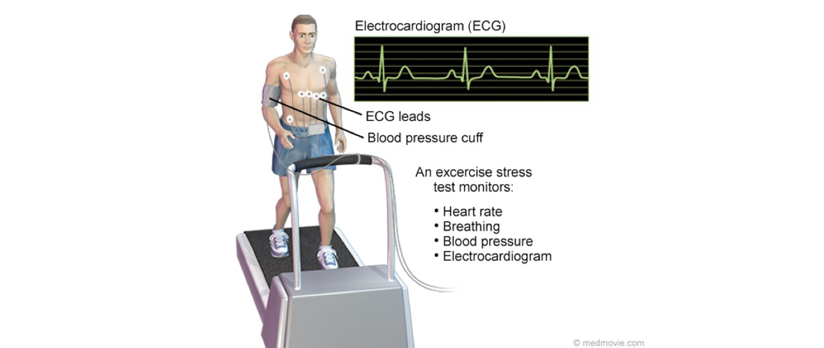
Alternative Diagnosis Methods
Stress Echocardiograms

Slide 8
Python Data Frameworks
Pandas
Scikit-learn
XGBoost
Keras
Matplotlib
Jupyter Notebook

Slide 9
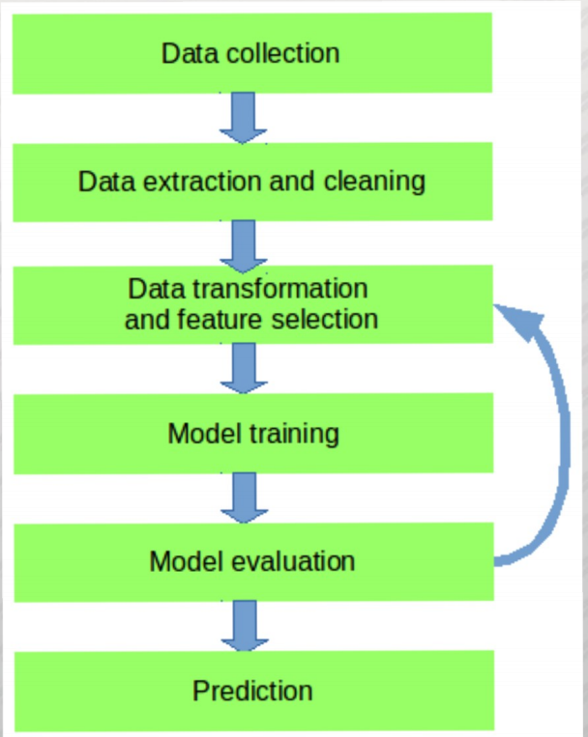
Classification Pipeline

Slide 10
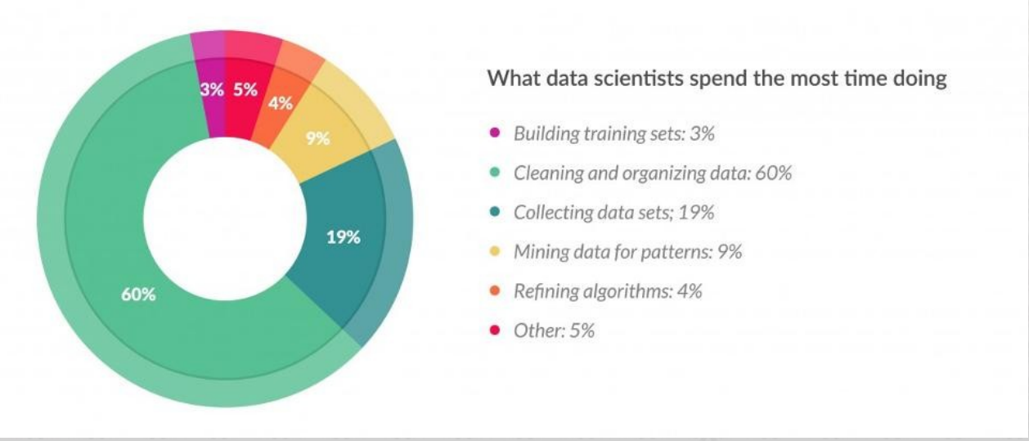
Data Preparation
http://www.forbes.com/sites/gilpress/2016/03/23/data-preparation-most-time-consuming-least-enjoyable-data-science-task-survey-says

Slide 11
DATA Collection and cleaning
The real world data are MESSY!
- Various Data Sources
- Different File Formats
- Data with Odd-formats
After cleaning the data we have about 300 patients data obtained from Kaggle (https://www.kaggle.com/ )

Slide 12
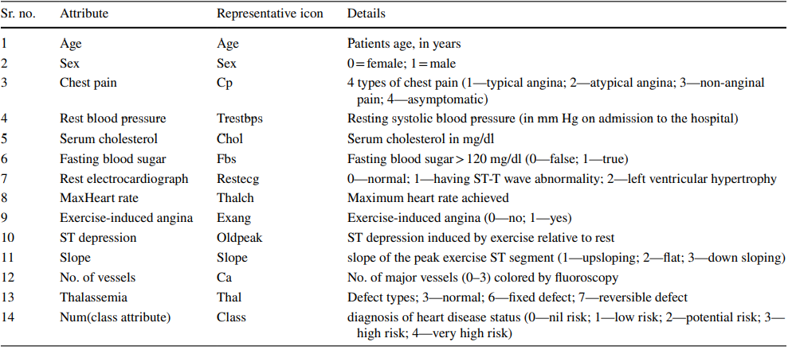
Data Features with their Description

Slide 13
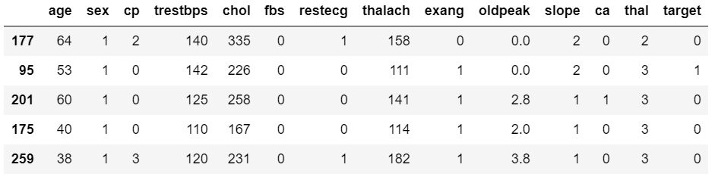
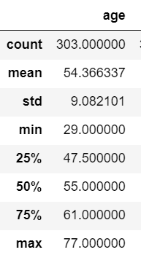
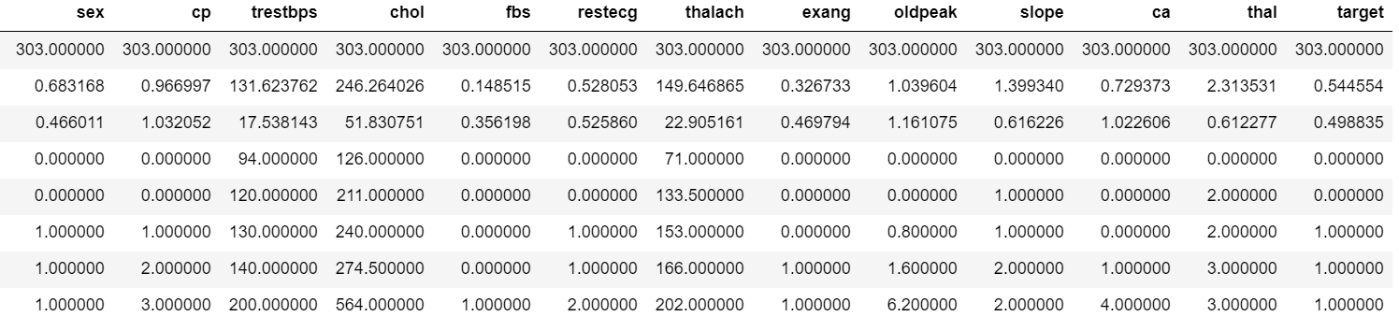

Slide 14
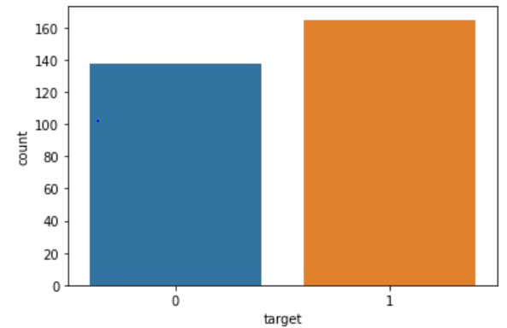
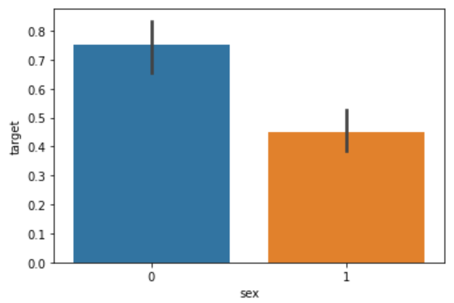
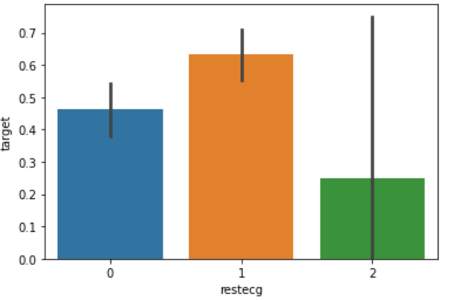
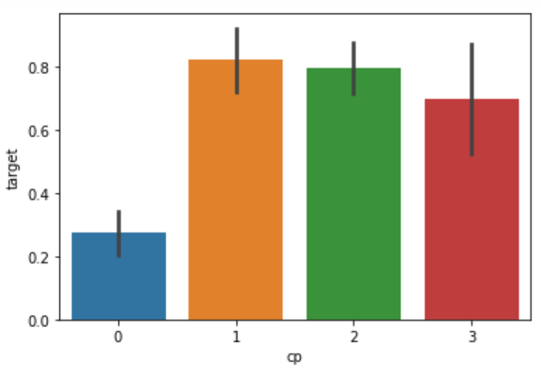
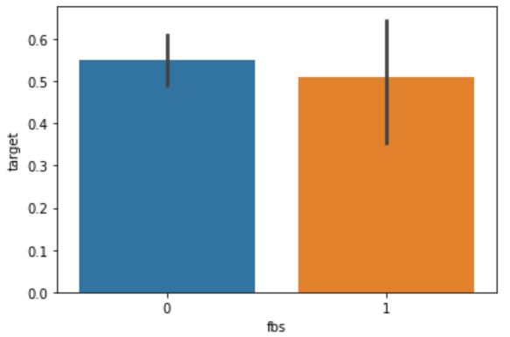
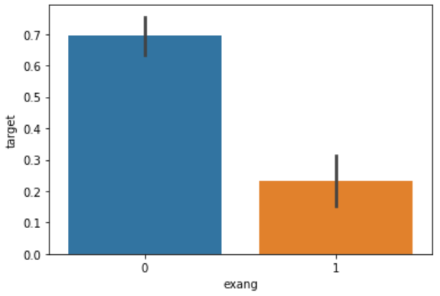
Exploratory Data Analysis

Slide 15
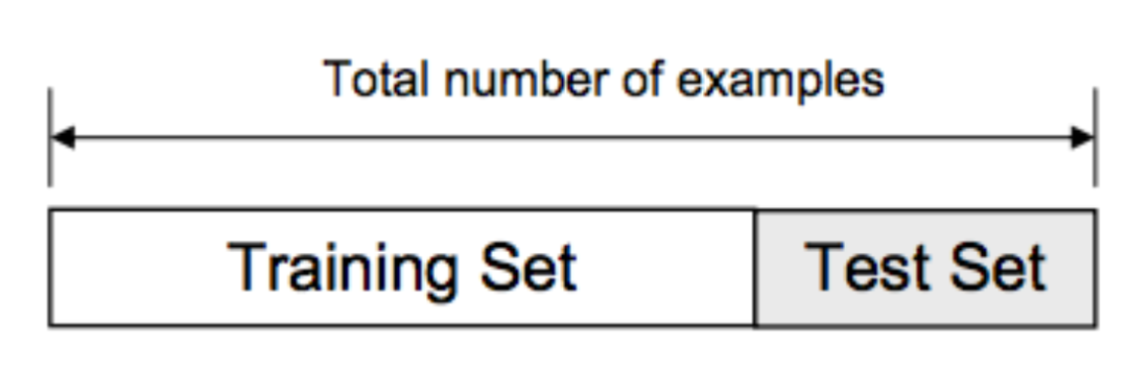
Train/Test Split
from sklearn.model_selection import train_test_split
predictors = dataset.drop("target",axis=1)
target = dataset["target"]
X_train,X_test,Y_train,Y_test = train_test_split(predictors,target,test_size=0.20,random_state=0)

Slide 16
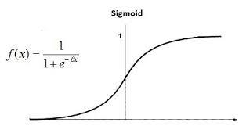
Logistic Regression
from sklearn.linear_model import LogisticRegression
lr = LogisticRegression()
lr.fit(X_train,Y_train)
Y_pred_lr = lr.predict(X_test)
score_lr = round(accuracy_score(Y_pred_lr,Y_test)*100,2)

Slide 17
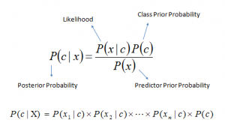
Naive Bayes
from sklearn.naive_bayes import GaussianNB
nb = GaussianNB()
nb.fit(X_train,Y_train)
Y_pred_nb = nb.predict(X_test)
score_nb = round(accuracy_score(Y_pred_nb,Y_test)*100,2)

Slide 18
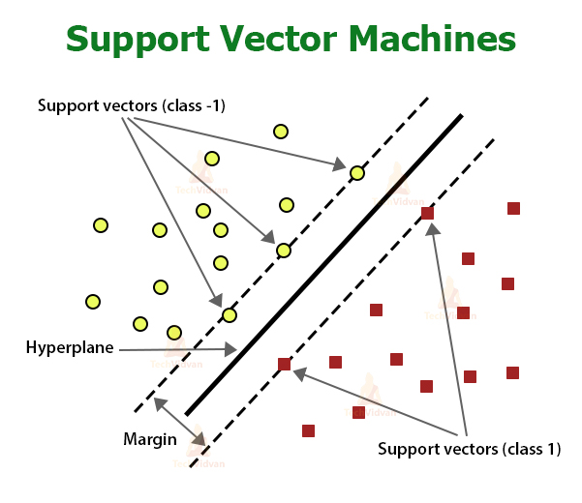
SVM
from sklearn import svm
sv = svm.SVC(kernel='linear')
sv.fit(X_train, Y_train)
Y_pred_svm = sv.predict(X_test)
score_svm = round(accuracy_score(Y_pred_svm,Y_test)*100,2)

Slide 19
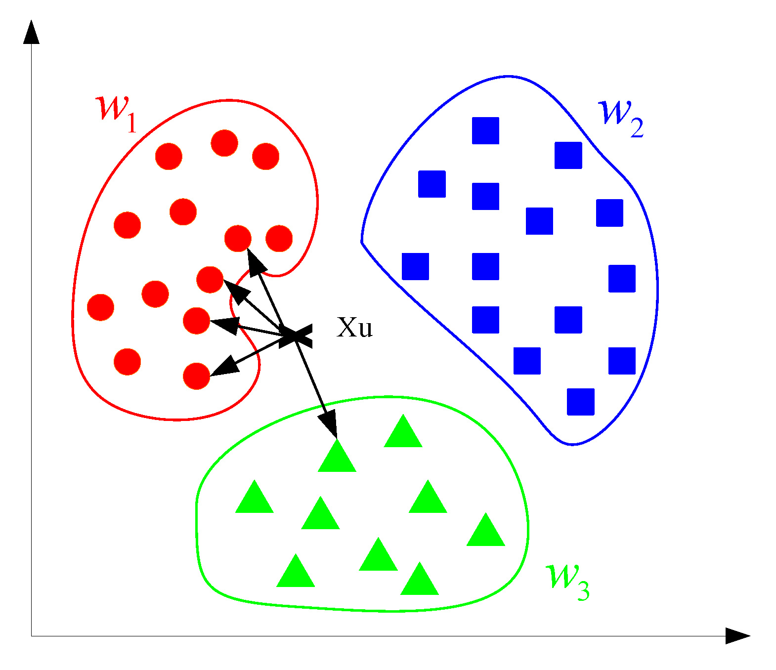
K Nearest Neighbors
from sklearn.neighbors import KNeighborsClassifier
knn = KNeighborsClassifier(n_neighbors=7)
knn.fit(X_train,Y_train)
Y_pred_knn=knn.predict(X_test)
score_knn = round(accuracy_score(Y_pred_knn,Y_test)*100,2)

Slide 20
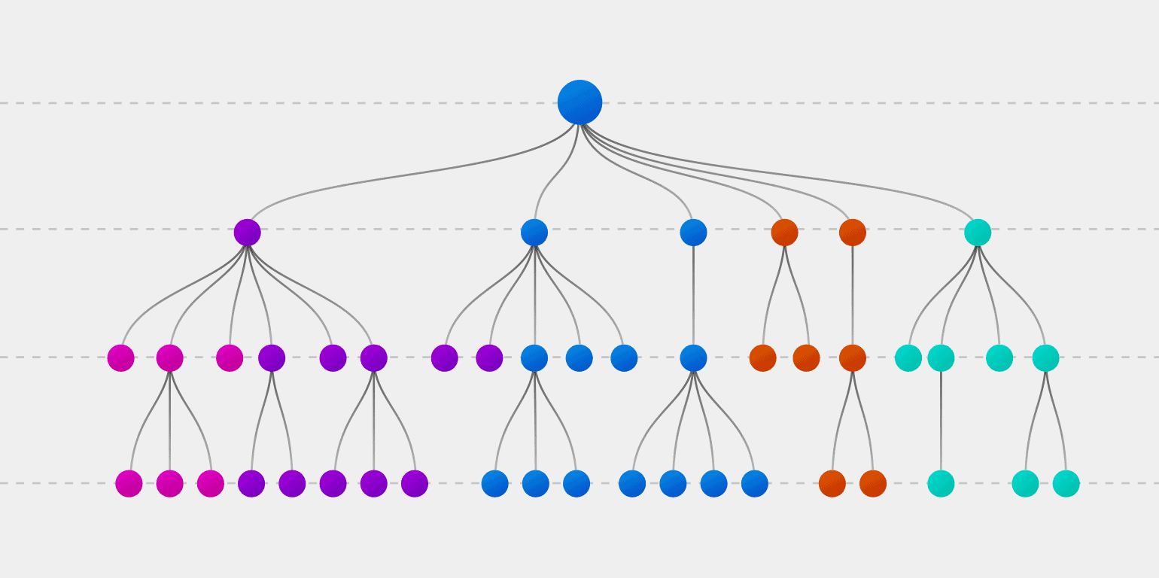
Decision Tree
from sklearn.tree import DecisionTreeClassifier
max_accuracy = 0
for x in range(200):
dt = DecisionTreeClassifier(random_state=x)
dt.fit(X_train,Y_train)
Y_pred_dt = dt.predict(X_test)
current_accuracy = round(accuracy_score(Y_pred_dt,Y_test)*100,2)
if(current_accuracy>max_accuracy):
max_accuracy = current_accuracy
best_x = x
dt = DecisionTreeClassifier(random_state=best_x)
dt.fit(X_train,Y_train)
Y_pred_dt = dt.predict(X_test)
score_dt = round(accuracy_score(Y_pred_dt,Y_test)*100,2)

Slide 21
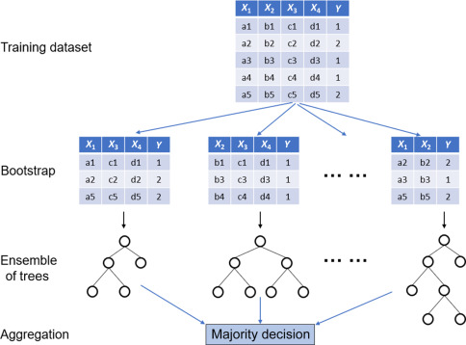
Random Forest
from sklearn.ensemble import RandomForestClassifier
max_accuracy = 0
for x in range(2000):
rf = RandomForestClassifier(random_state=x)
rf.fit(X_train,Y_train)
Y_pred_rf = rf.predict(X_test)
current_accuracy = round(accuracy_score(Y_pred_rf,Y_test)*100,2)
if(current_accuracy>max_accuracy):
max_accuracy = current_accuracy
best_x = x
rf = RandomForestClassifier(random_state=best_x)
rf.fit(X_train,Y_train)
Y_pred_rf = rf.predict(X_test)
score_rf = round(accuracy_score(Y_pred_rf,Y_test)*100,2)

Slide 22
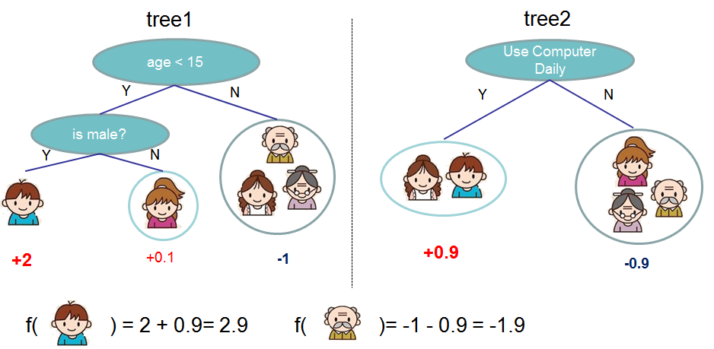
XGBoost
import xgboost as xgb
xgb_model = xgb.XGBClassifier(objective="binary:logistic", random_state=42)
xgb_model.fit(X_train, Y_train)
Y_pred_xgb = xgb_model.predict(X_test)
score_xgb = round(accuracy_score(Y_pred_xgb,Y_test)*100,2)

Slide 23
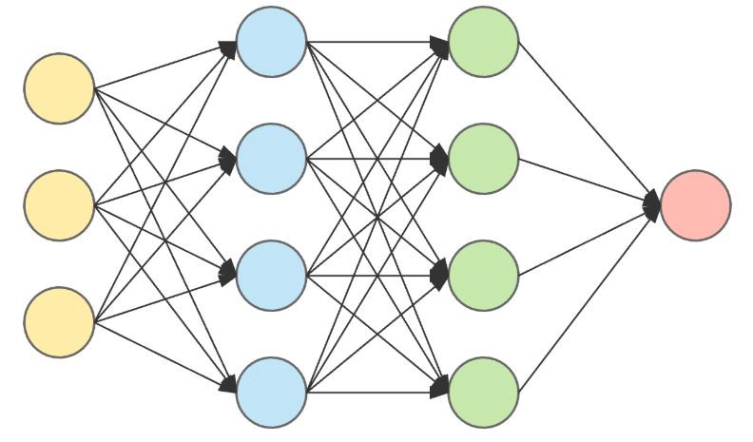
Neural Networks
from keras.models import Sequential
from keras.layers import Dense
model = Sequential()
model.add(Dense(11,activation='relu',input_dim=13))
model.add(Dense(1,activation='sigmoid'))
model.compile(loss='binary_crossentropy',optimizer='adam',metrics=['accuracy'])
model.fit(X_train,Y_train,epochs=300)
Y_pred_nn = model.predict(X_test)
rounded = [round(x[0]) for x in Y_pred_nn]
Y_pred_nn = rounded
score_nn = round(accuracy_score(Y_pred_nn,Y_test)*100,2)

Slide 24
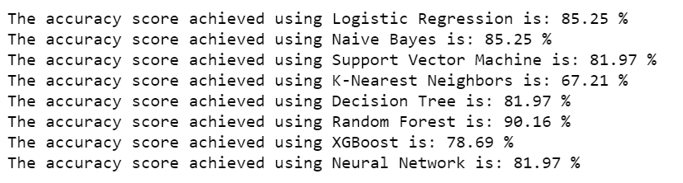
Final Accuracy From Different Models
scores = [score_lr,score_nb,score_svm,score_knn,score_dt,score_rf,score_xgb,score_nn]
algorithms = ["Logistic Regression","Naive Bayes","Support Vector Machine","K-Nearest Neighbors","Decision Tree","Random Forest","XGBoost","Neural Network"]
for i in range(len(algorithms)):
print("The accuracy score achieved using "+algorithms[i]+" is: "+str(scores[i])+" %")

Slide 25
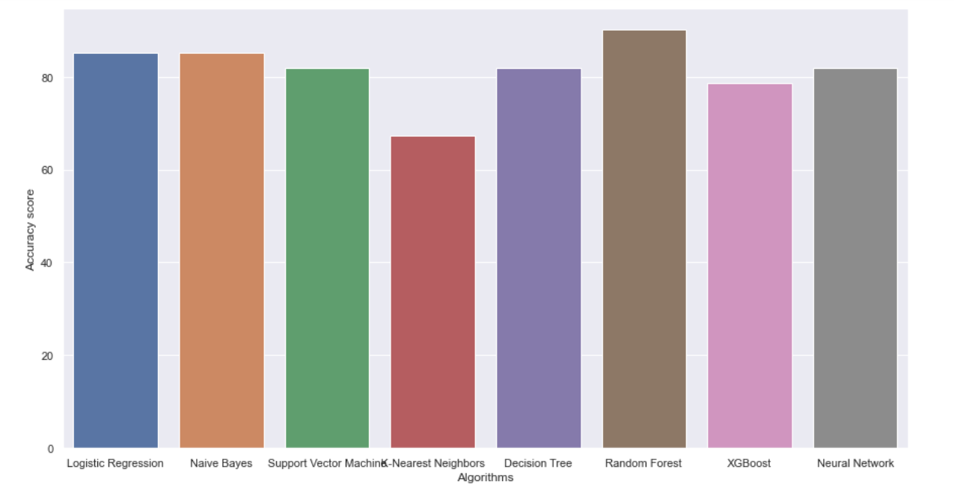

Slide 26
Conclusion
The Random Forest is happens to be best of all other models in finding out the heart disease with the accuracy of 90%.

